Slide 1
Medical Record Classification
Top N Similar Records Approach

Slide 2
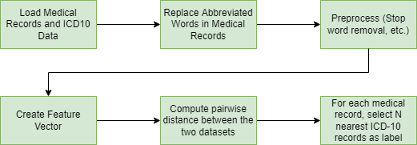
General Approach

Slide 3
Preprocessing and Feature Vector
Preprocessing involved the following steps:
Convert to lower case
Replace abbreviations
Remove all symbols and whitespace character (except space)
Remove all stop words (specified in spacy)
The feature vector was created in two steps
Get feature vector using TF-IDF Vectorizer
Using Truncated SVD to reduce dimensionality

Slide 4
Level in ICD-10
Level Identifier | Example | Total Labels
Level 1 | A00-B99 Certain infectious and parasitic diseases | 22
Level 2 | A00-A09 Intestinal infectious diseases | 258
Level 3 | A01 Typhoid and paratyphoid fevers | 1911
Exact Code | A00.9 Cholera, unspecified | 69000+

Slide 5
Grid Search
The ideal parameters were identified using grid search. The parameters considered are:
Level in ICD 10 hierarchy
Level 1
Level 2
Level 3
ICD 10 description
Description of the selected code
Description of selected code + description of descendants
Corpus for training feature vector
Only medical records
Only code description
Both

Slide 6
Grid Search
Stop words in training TF-IDF vectorizer
English
None
Feature Length for Truncated SVD
5, 10 or 25
Suggested Label Count
1,2,3,4,…,10
Distance Metric
Cosine, Euclidean, Manhattan, Chebyshev and Minkowski

Slide 7
Results for Level 1
The best result for level 1 are as follows:
F-Score (0.45334872)
ICD 10 description | All
Corpus | All
Stop Word | None
Feature Length | 5
Suggested Label | 2
Distance Metric | Euclidean/Minkowski
Recall | 0.451
Precision | 0.518

Slide 8
Results for Level 2
The best result for level 2 are as follows:
F-Score (0.25)
ICD 10 description | All
Corpus | All
Stop Words | English
Feature Length | 5
Suggested Label | 5
Distance Metric | Euclidean/Minkowski
Recall | 0.351
Precision | 0.216

Slide 9
Results for Level 3
The best result for level 3 are as follows:
F-Score (0.116)
ICD 10 description | All
Corpus | All
Stop Words | English
Feature Length | 25
Suggested Label | 5
Distance Metric | Euclidean/Minkowski
Recall | 0.159
Precision | 0.103

